Slide 1
INNO-TREC Project in brief
INNOvative Transactive Renewable Energy Communities
Innovation Action

Slide 2
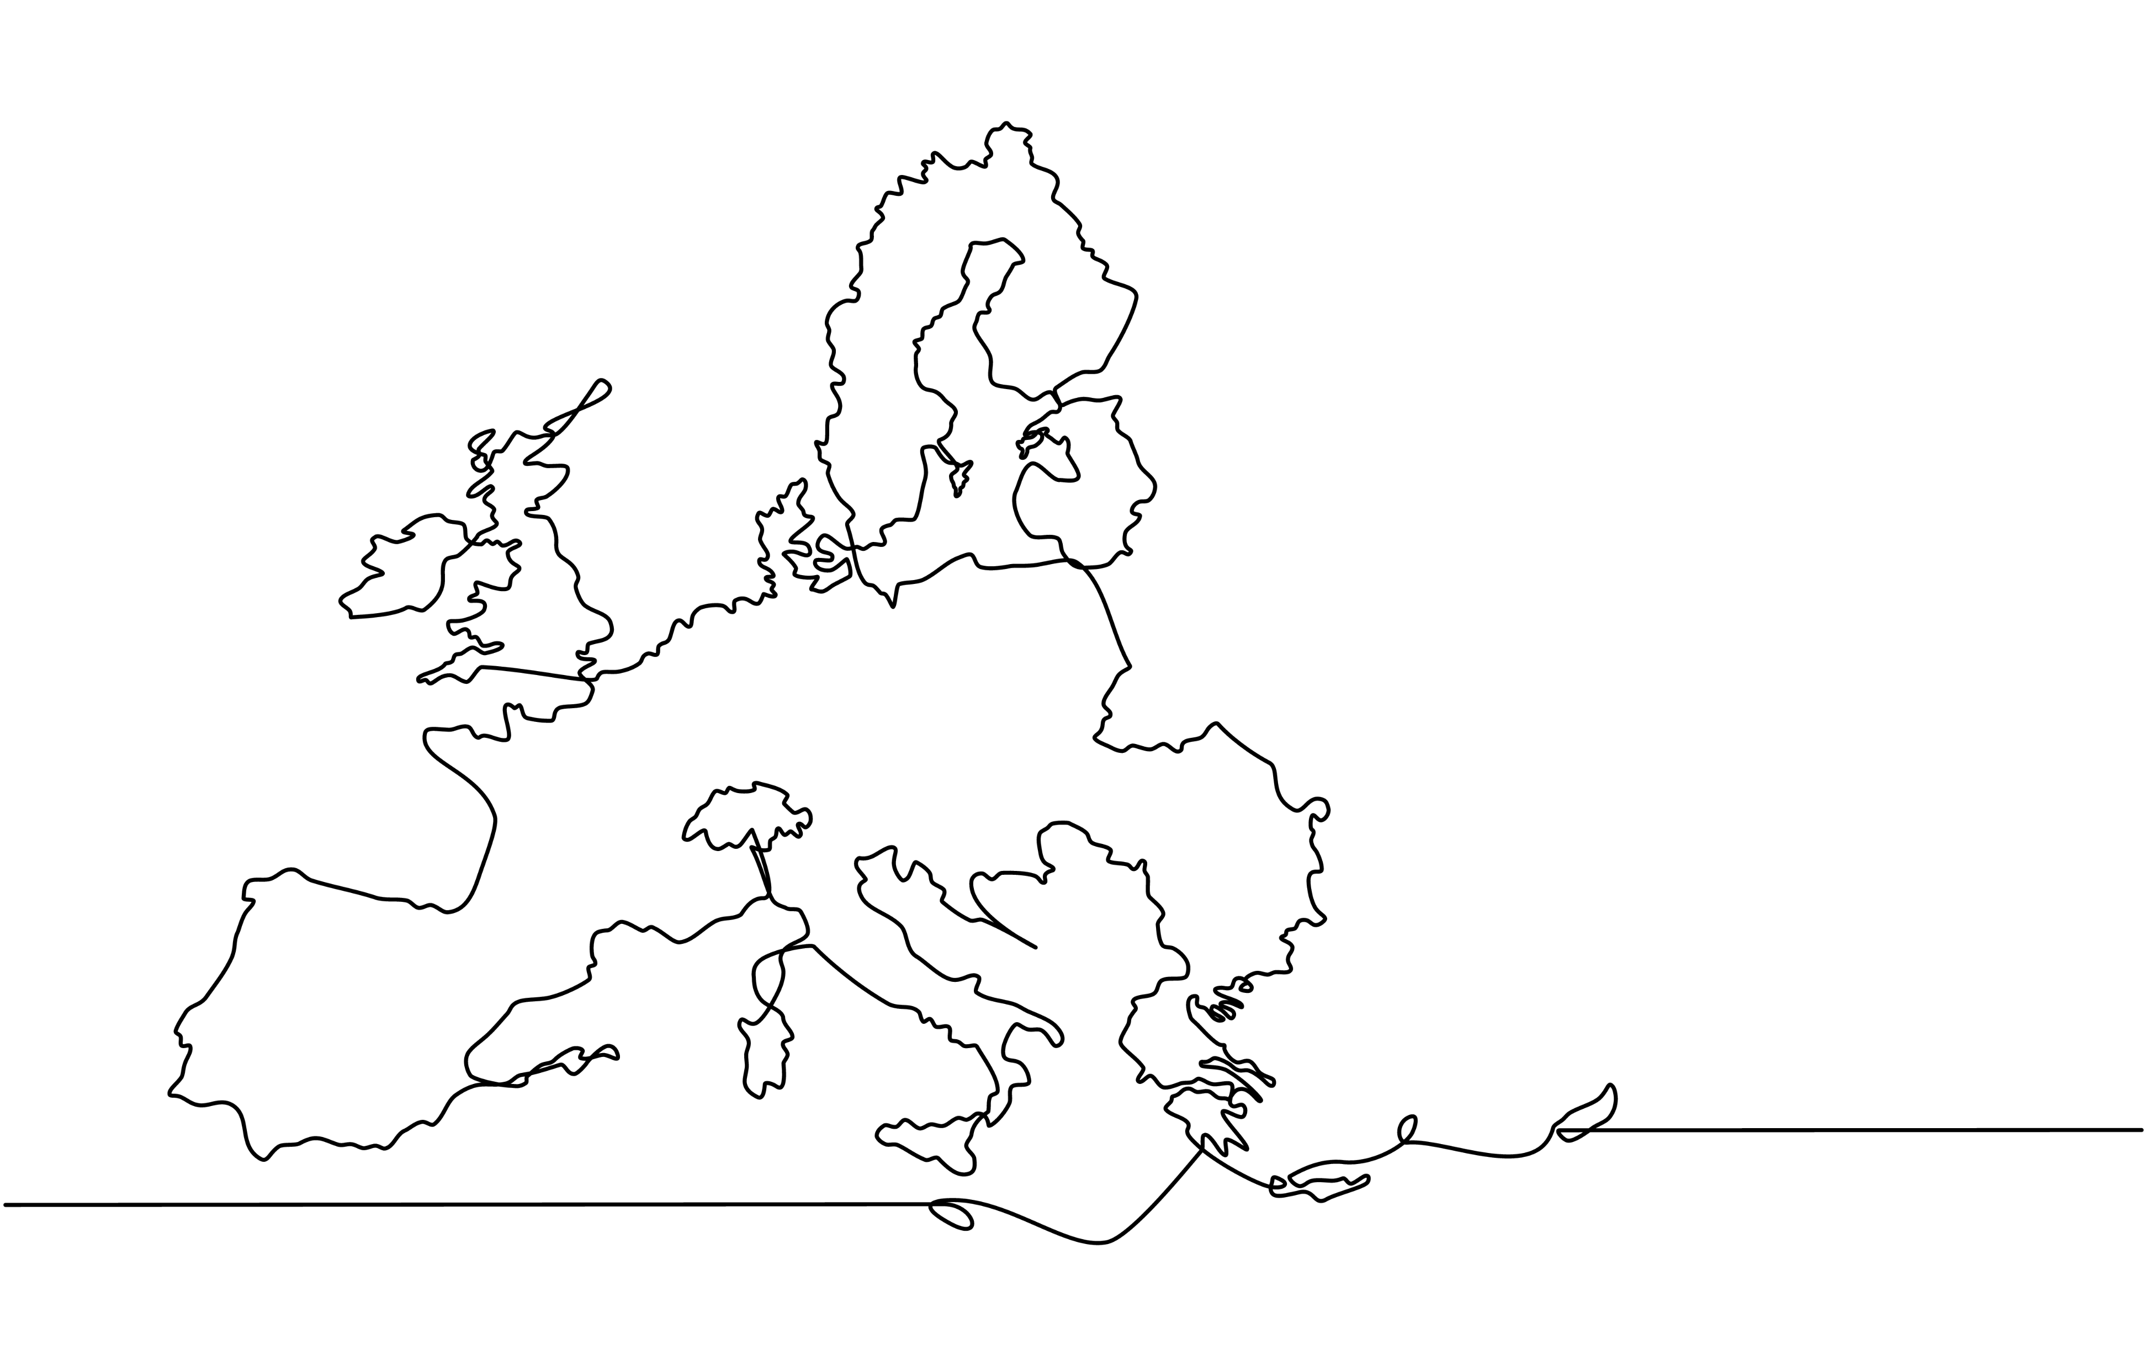
Overview
INNO-TREC lays the foundations for a new generation of energy communities: efficient, inclusive, and sustainable.
Grant Agreement ID: 101230578
January 2026-June 2029
Total Cost: 5.3M
20 partners from 10 countries, coordinated by UPorto
Six demos in six countries
TRL 6-7 results

Slide 3

Objectives
Develop an open-source reference architecture for secure data exchange
Create AI-driven decision support tools for REC optimisation
Design simulation and modelling tools for PV systems and energy flows
Build a blockchain-based energy credits platform for transparent peer-to-peer transactions
Foster community engagement and social innovation
Validate flexibility mechanisms and economic models for profitable RECs

Slide 4
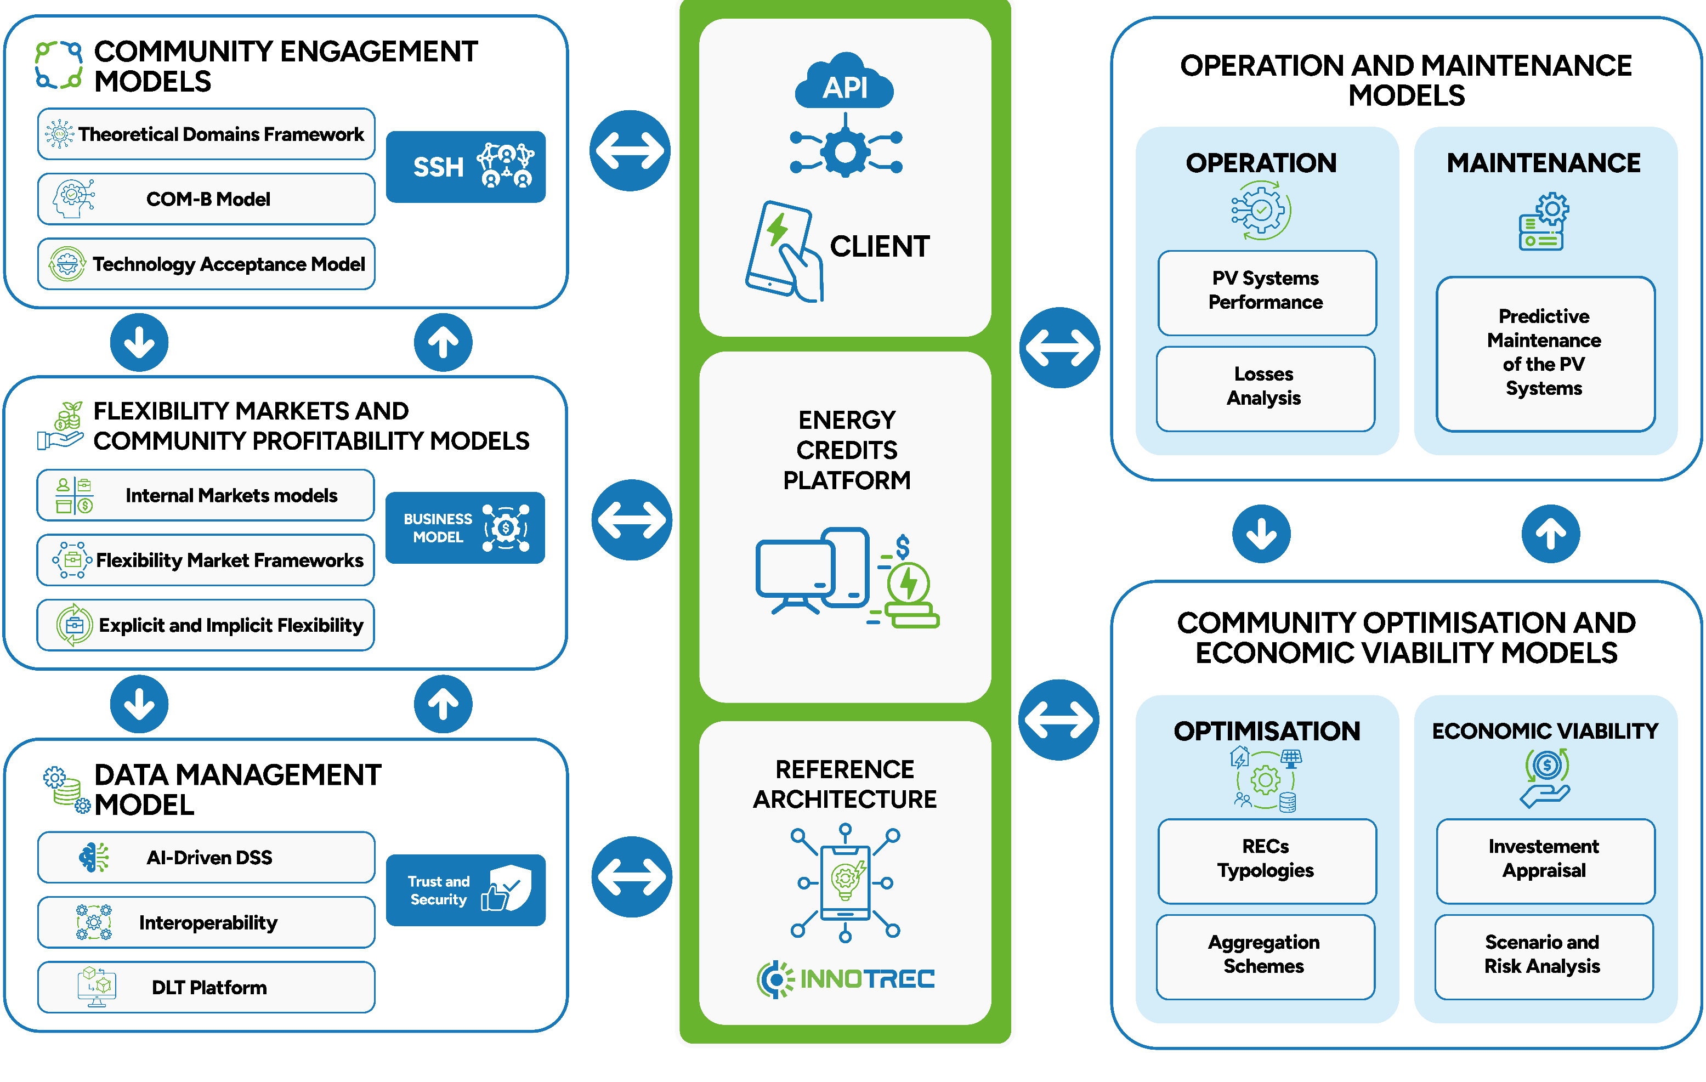
Our concept
Local Value Exchange: A new energy credits platform lets members exchange energy value directly with each other, reducing costs and dependence on traditional energy markets.
Smart Decision-Making: An AI‑powered Decision Support System helps communities make better choices about energy use, planning, and operations.
Connected Platforms: A federation of platforms lets different communities share useful data across sectors, making collaboration easier.
Secure Data: Distributed Ledger Technology (DLT) keeps data exchanges secure and trustworthy.
Open and Compatible: INNO‑TREC uses open APIs and common communication standards
Strong Social Focus: Social science experts help shape the technology, so it delivers real social benefits and supports innovation within communities.

Slide 5
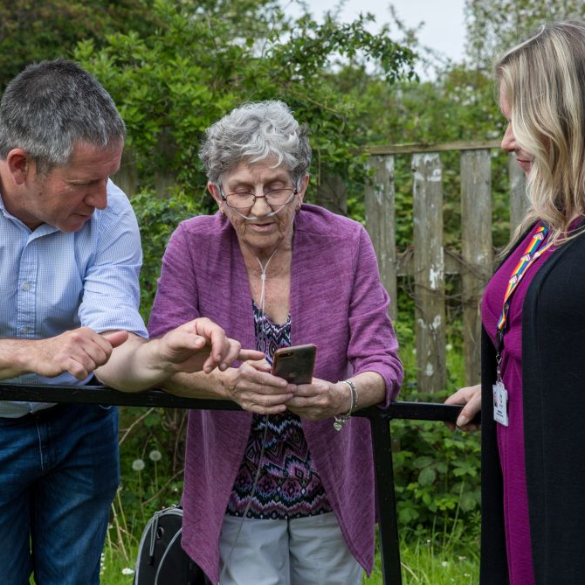
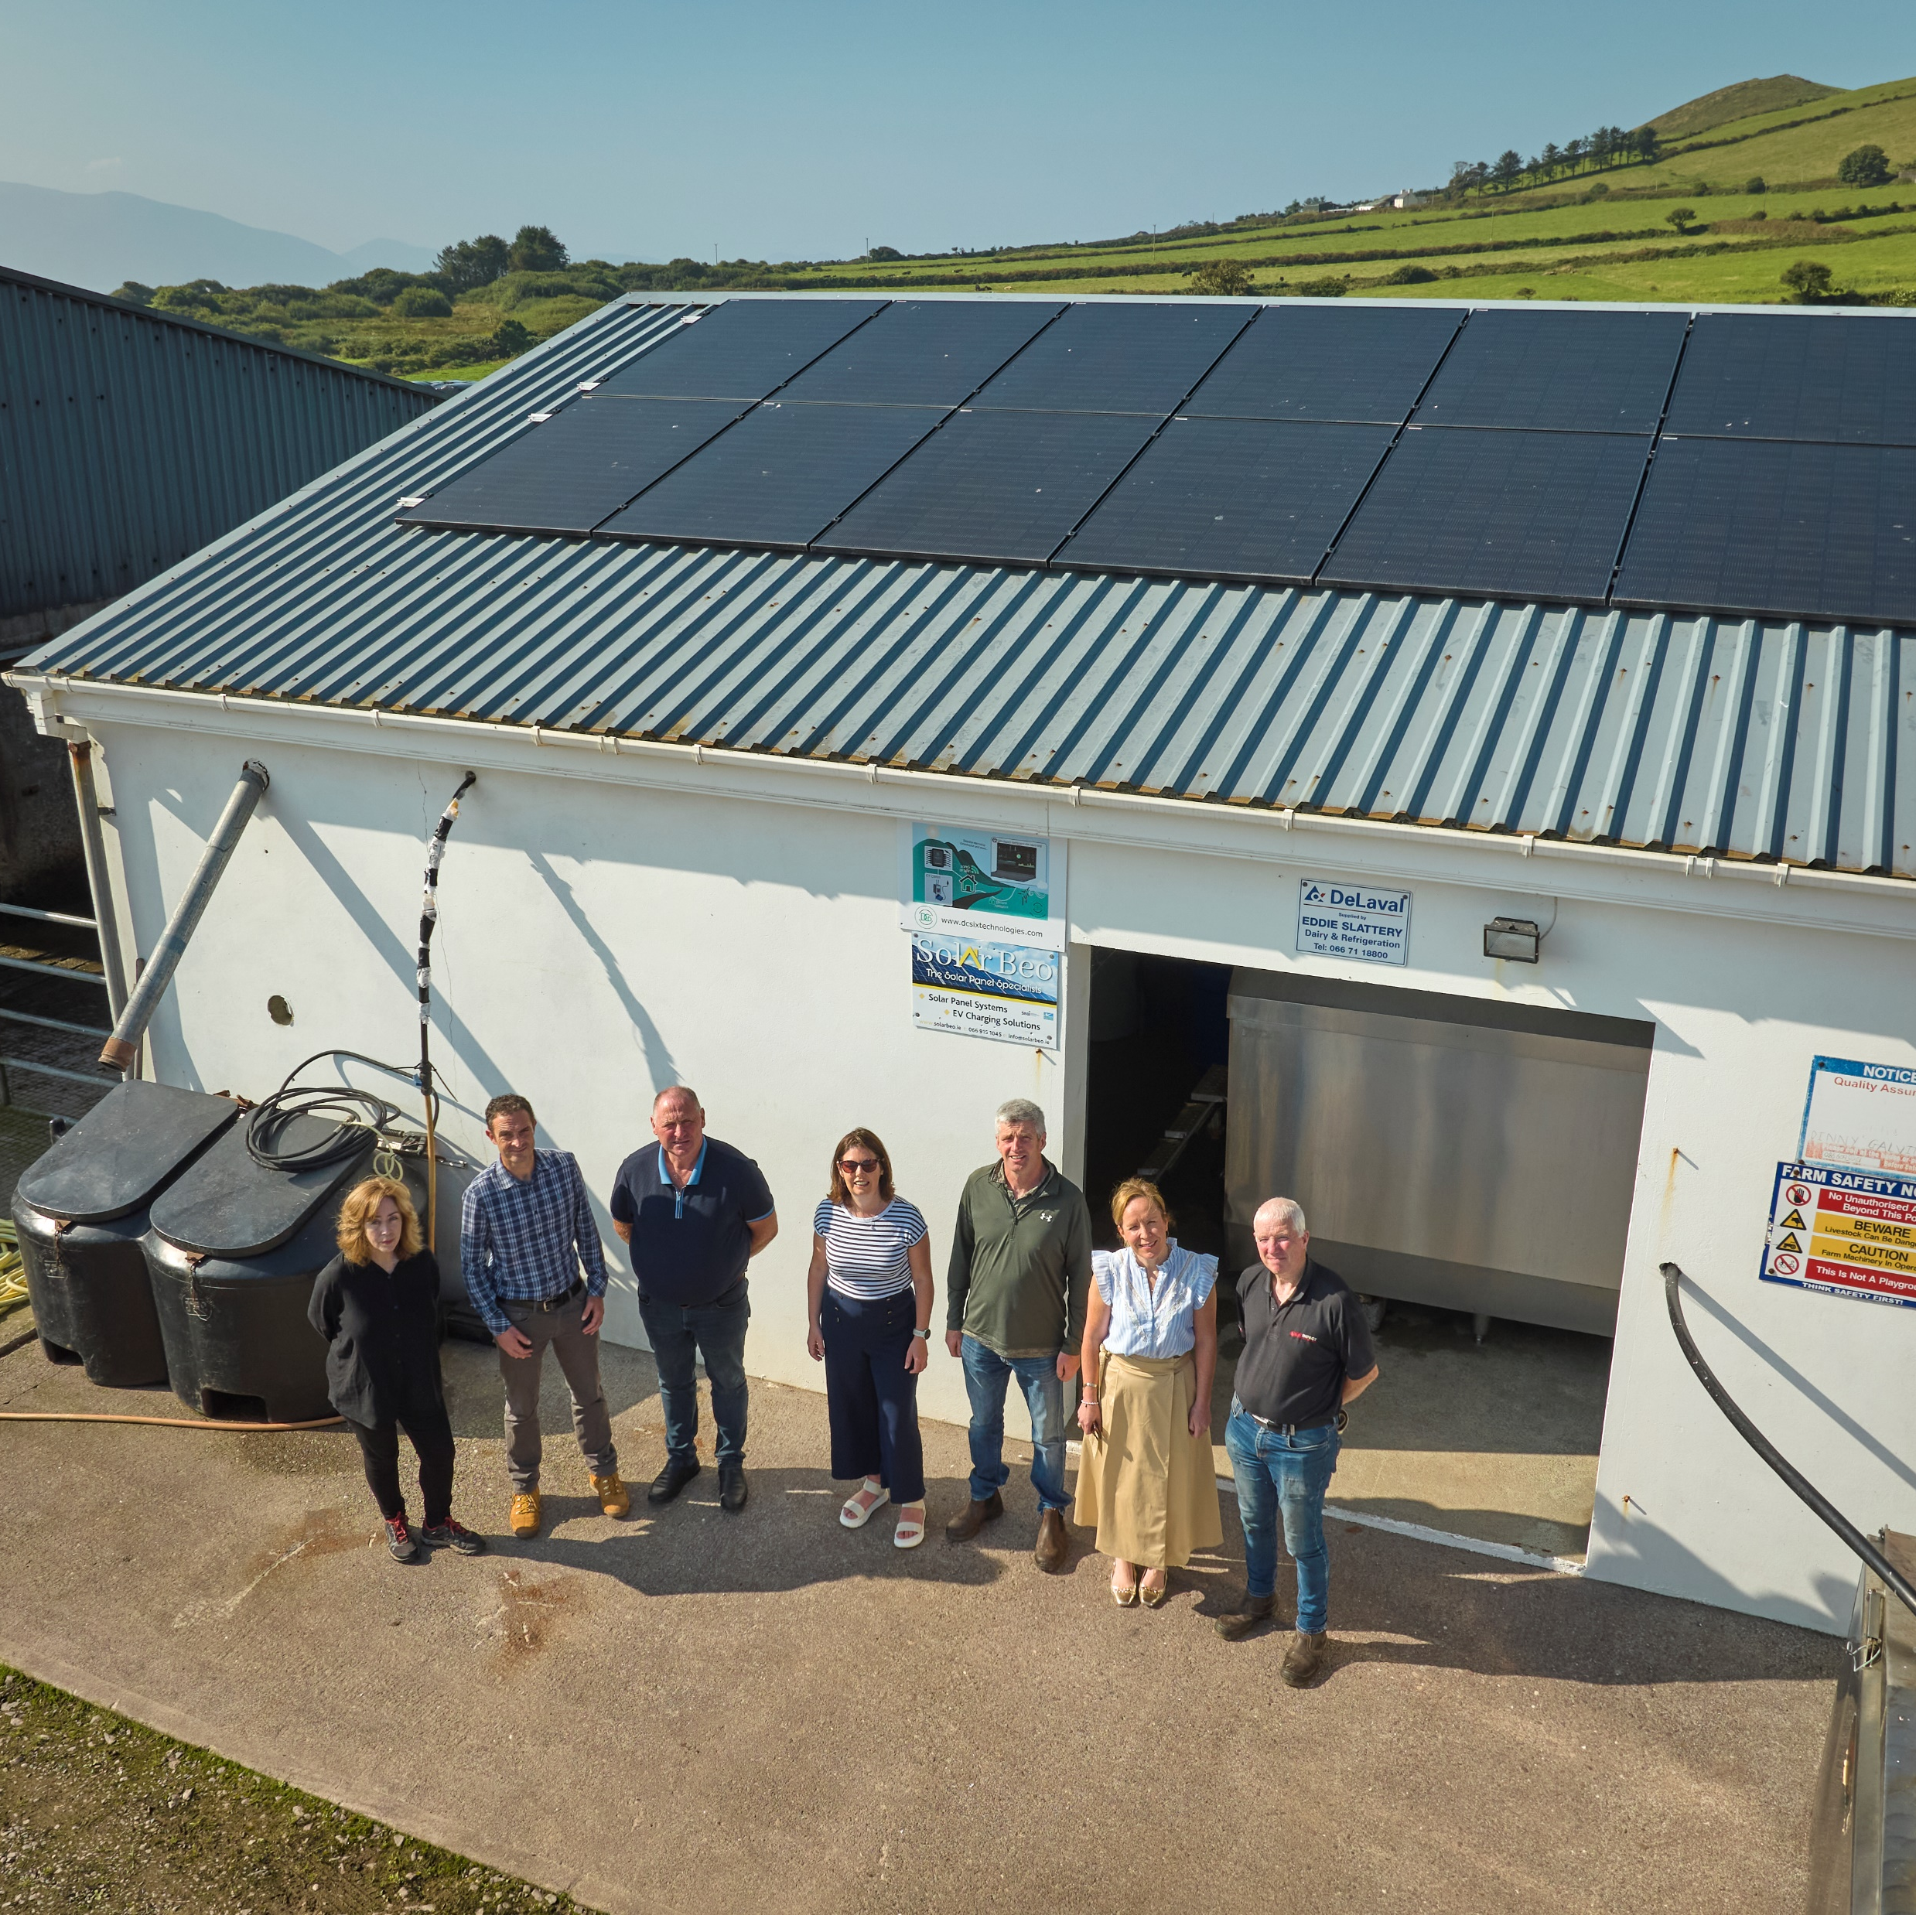
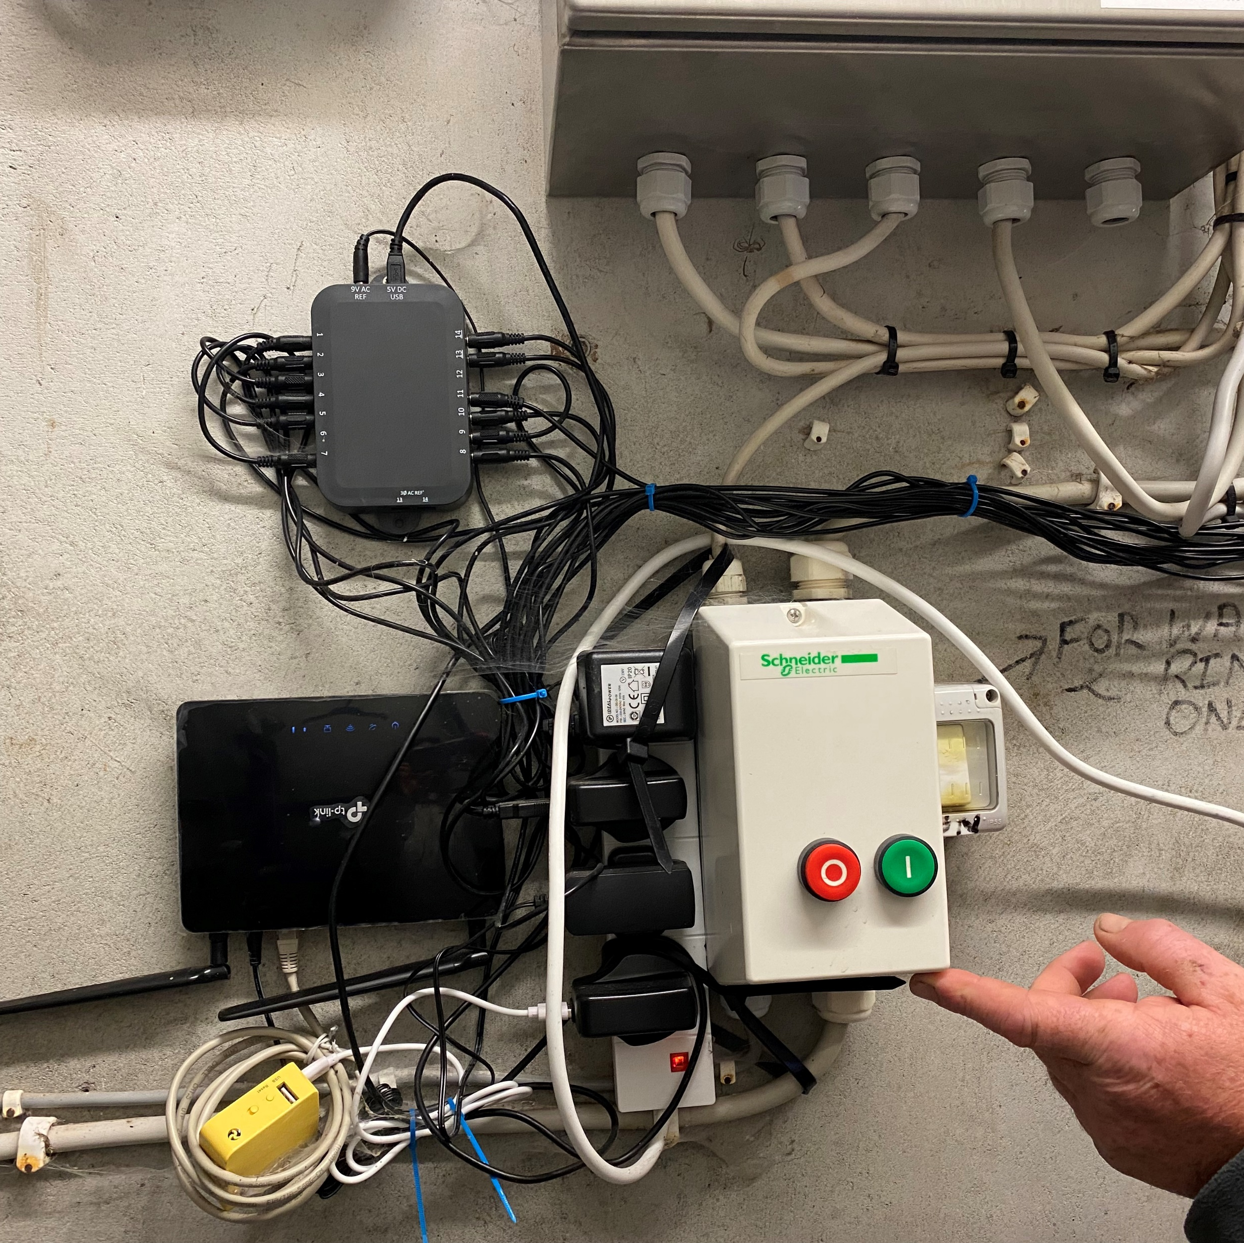
What we deliver
INNO-TREC will provide free, user-friendly, web-based tools to help communities:
Set up RECs (member engagement, PV system sizing)
Operate efficiently (performance monitoring, predictive maintenance)
These tools will reduce dependency on third-party services, lower costs, and make REC management accessible to all.

Slide 6
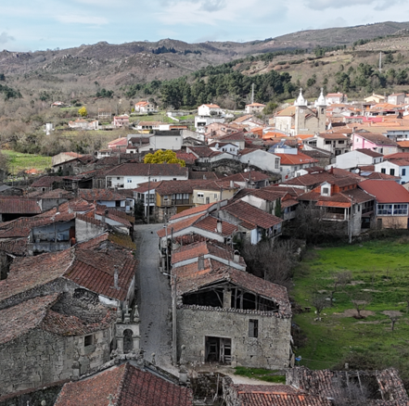

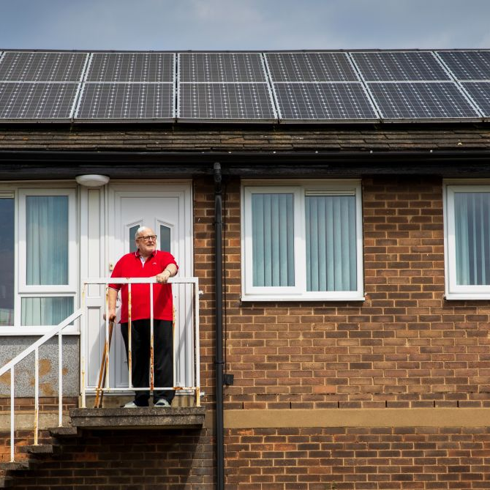
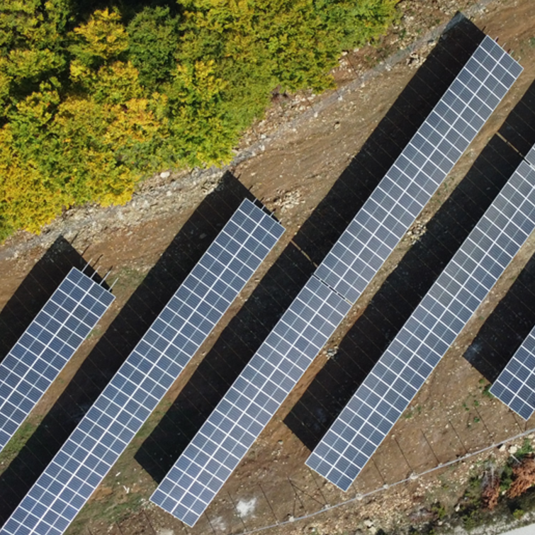
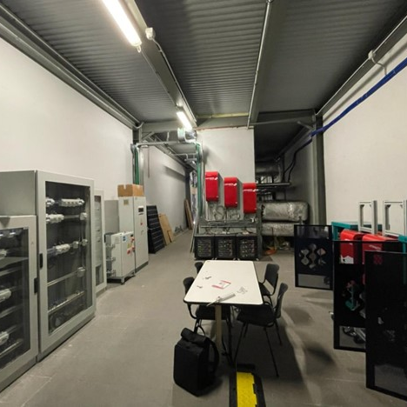
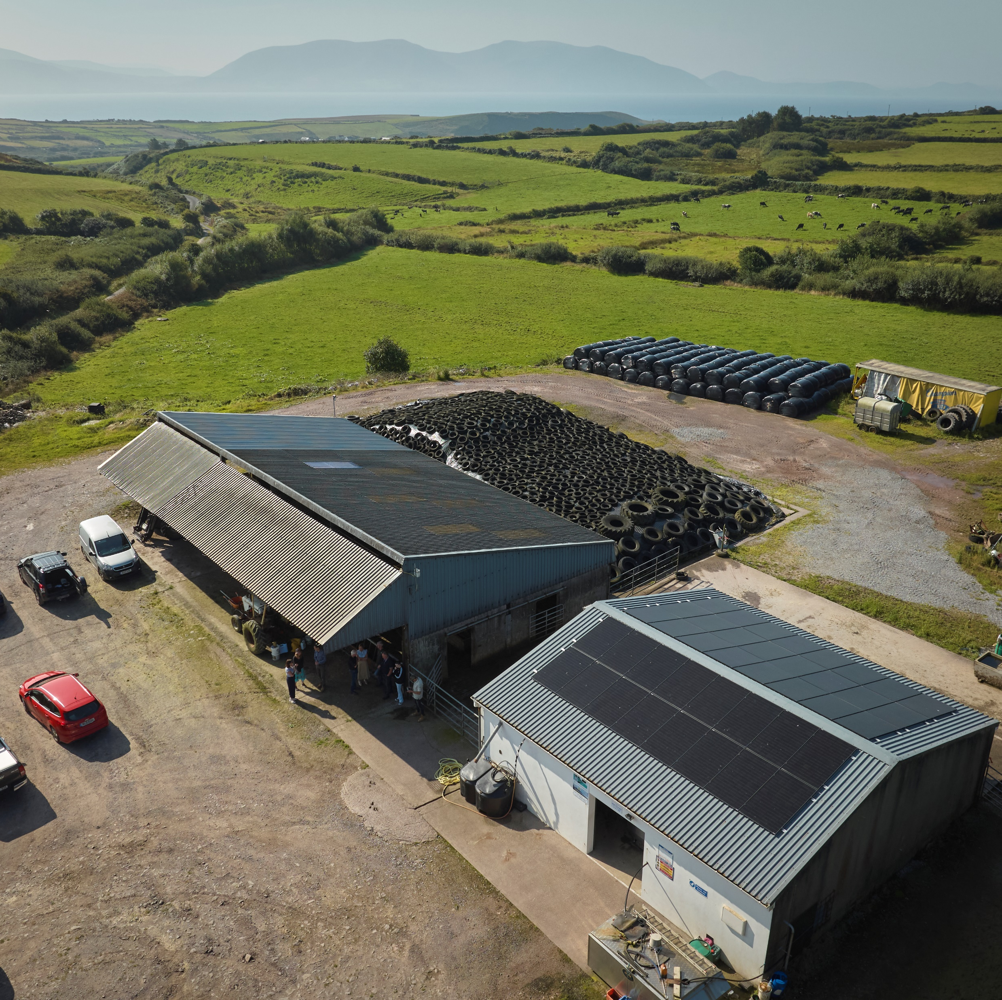
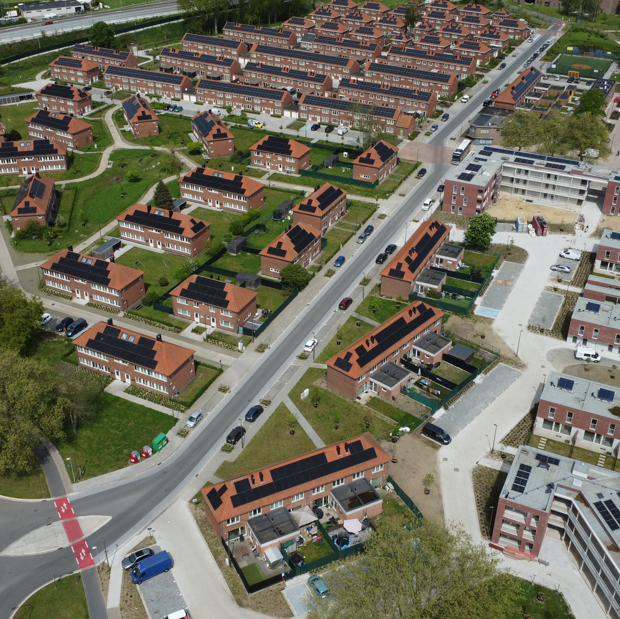
The demos

Slide 7








How will RECs benefit
Self-Sustaining Communities
Technological Empowerment
Increased PV Systems Performance
Increased Energy Efficiency
Reduced Energy Poverty
Environmental Sustainability
Social Equity
Economic Resilience
REC profitability

Slide 8


Broader impact
INNO-TREC aims to deliver measurable benefits across technological, economic, and social dimensions:
Technological:
+25% energy efficiency
+70% predictive accuracy
+35% self-consumption
Economic:
+30% local energy trading
+25% PV revenues
-32% cost
Social:
-15% energy poverty
+20% energy literacy
+60% technology acceptance
Environmental:
-33% CO₂ emissions

Slide 9



















CONSORTIUM

Slide 10


inno-trec.eu/
linkedin.com/company/inno-trec/

